Slide 1

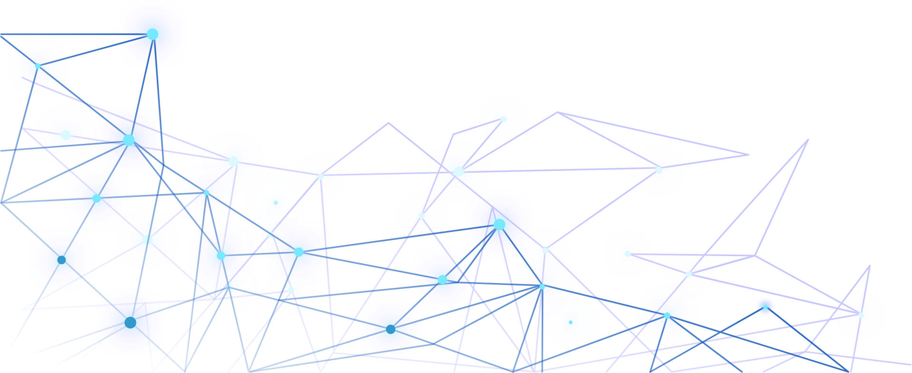

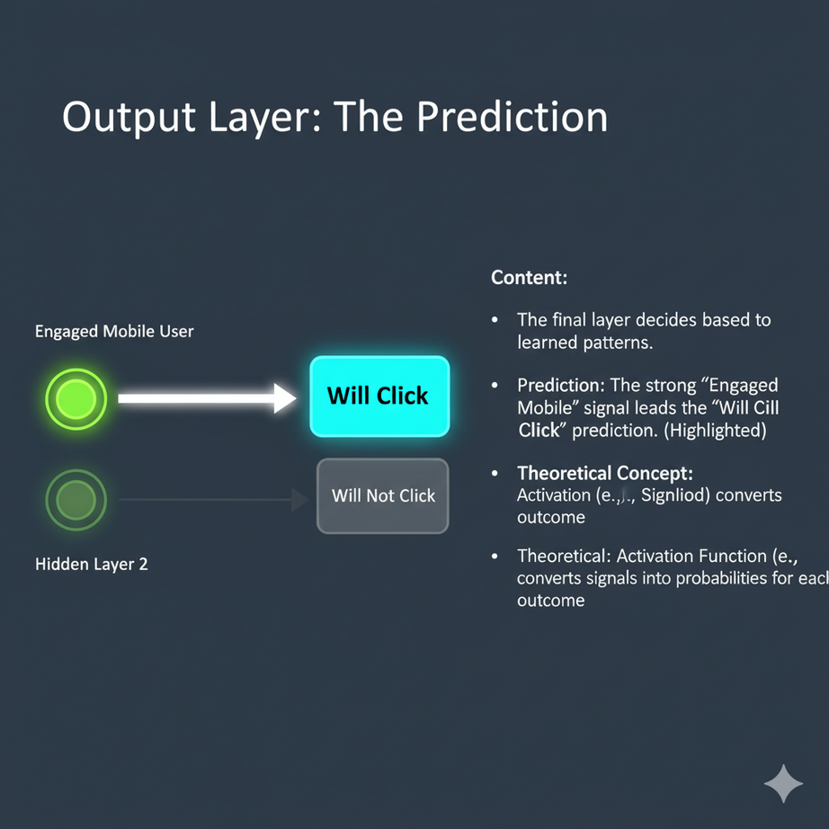
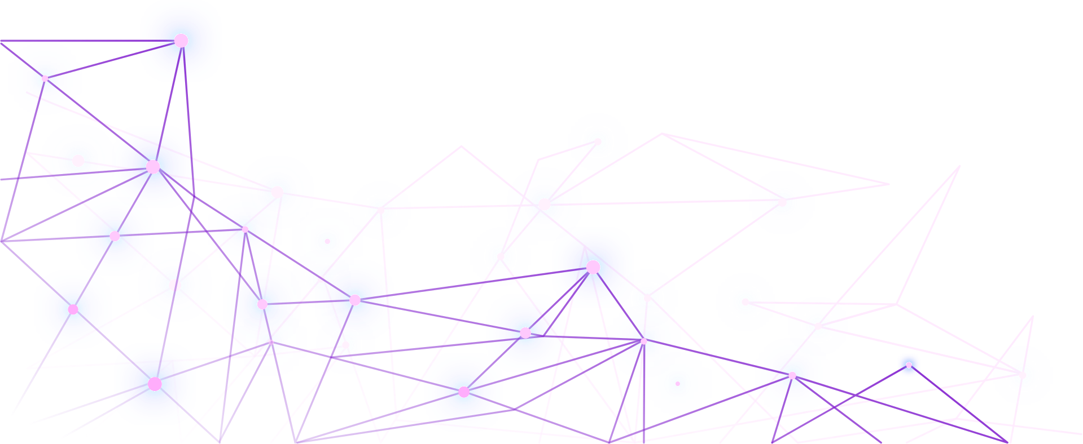


Output Layer: The Prediction
The Output Layer is the end result of all the weighted processing. It takes the final, abstract feature ("Highly Engaged Mobile User") and translates it into a final decision.
Prediction: Because the signal for "High Engagement" was so strong through the preceding layers, my network outputs a high probability for "Will Click." I highlight this outcome as the network's final decision.
Theoretical Concept Activation Function: I use a Sigmoid activation function here. This converts the final numeric score into a clear probability between 0 and 1. For instance, a score of 0.90 means I am 90% confident the customer will click.
The Decision Function: I use a Sigmoid activation function in this final layer. This function squashes the aggregated score from Hidden Layer 2 into a probability between 0 and 1. If the score is high, it yields a high probability (e.g., 0.90 or 90% chance of Click).
Prediction and Confidence: My prediction, "Will Click," is not just a guess; it's a high-confidence probability result of all the weighted calculations performed across the three layers.

Slide 2



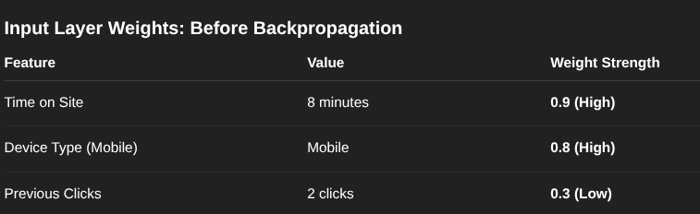
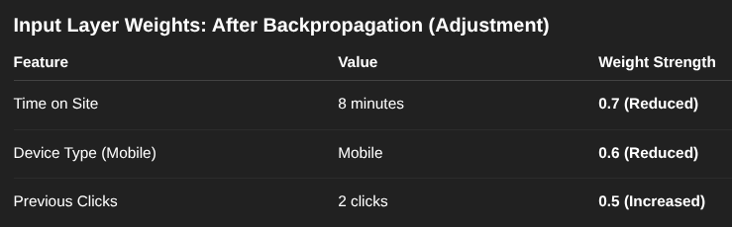
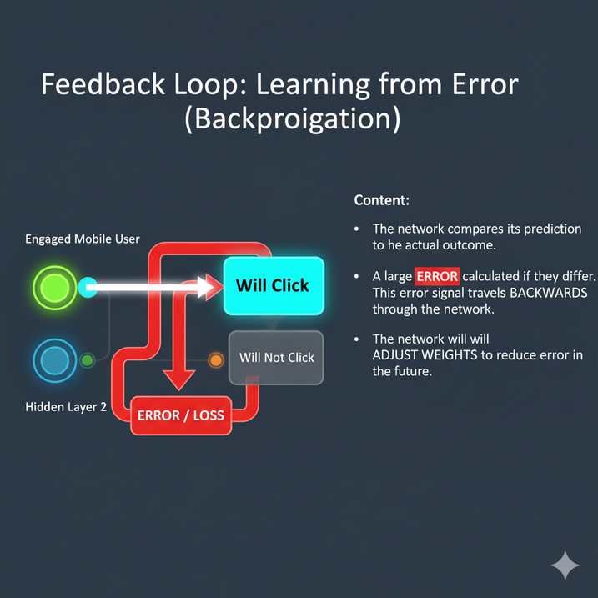
Feedback Loop: Learning from Error (Backpropagation)
This is the critical learning step. I compare my network's prediction to the actual outcome for that customer.
The Error: My network predicted the customer "Will Click," but the customer "Did Not Click" the ad. This creates a large error (the difference between the 90% confidence and the 0% outcome).
The Process: I introduce Backpropagation. This is the method where the error signal travels backward from the Output Layer, through the Hidden Layers, and back to the Input Layer.
Calculating Loss: The first step is to quantify the mistake using a Loss Function (like binary cross-entropy, common for this type of problem). This function measures the magnitude of the difference between my 90% prediction and the 0% true outcome. A large difference equals a large Error or Loss.
Goal: The error guides the network on how to adjust its internal settings (the weights) so that next time, it will be more accurate.

Slide 3

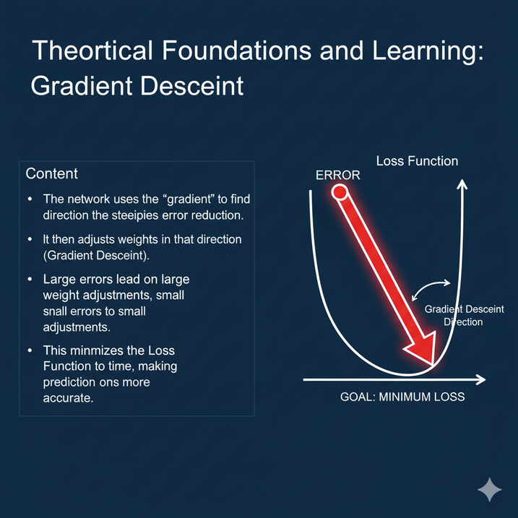

Adjusting Weights: Guided by Theory
Applying Theory: The method I use to fix the weights is called Gradient Descent. The error I found in the feedback loop tells me how far off I was. The gradient (a mathematical slope) tells me which direction to adjust each weight to minimize the error.
The Problem: The network wrongly placed too much emphasis (high weights) on Time on Site and Mobile Device.
The Adjustment: Using the backpropagated error, I must now calculate the specific contribution of those high weights to the large error. I will then perform a Weight Update by slightly reducing the weights associated with "Time on Site" and "Mobile Device" inputs. I might also slightly increase the weight for "Previous Clicks" to see if that feature holds more predictive power than I initially thought.
Theoretical Reference: This entire process is the application of the Stochastic Gradient Descent (SGD) algorithm, which is the foundational learning algorithm in deep learning.
The Weight Update Formula: The formula is conceptually: New Weight=Old Weight−(Learning Rate×Gradient). The Learning Rate is a small number I set to control how big the step is down the slope.

Slide 4



Reflection and Real-World Applications
Connection Strength (Weights): I determined the initial weight strengths based on intuition, but the actual, effective strengths are only finalized by the Gradient Descent learning process. Large errors, like the one I observed, lead to large adjustments in the weights to quickly correct the network's bias.
Enhancing Accuracy: To further improve, I could switch from a simple sigmoid function to a more complex ReLU (Rectified Linear Unit) in the hidden layers. I could also implement an advanced Optimizer like Adam, which adapts the learning rate for each weight individually, speeding up the overall convergence and prediction accuracy.
Real-World Application: This specific model directly applies to Personalized Marketing and Credit Risk Assessment. Any scenario requiring a probability of a binary outcome (Yes/No, Buy/Not Buy, Fraud/Not Fraud) uses these exact theoretical principles to make high-stakes decisions automatically.
Connection Strength Rationale: I used the error's magnitude to drive the size of the weight update. This application of the Gradient Descent principle is fundamental: the steeper the error slope, the larger the change in the weights, leading to faster learning.

Slide 5



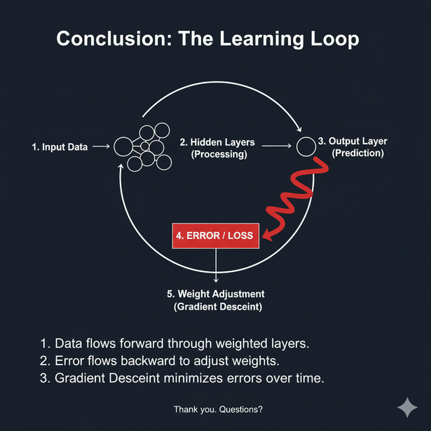

Conclusion: Key Takeaways
I've successfully demonstrated how a neural network processes data through weighted layers.
The network's intelligence comes not from its architecture, but from the powerful learning mechanism called Backpropagation.
By applying foundational concepts like Gradient Descent, I can ensure the network continuously reduces its errors and refines its understanding of the data.
References:
“Dive into Deep Learning — Dive into Deep Learning 0.16.0 Documentation.” D2l.ai, d2l.ai/.
Nielsen, Michael A. “Neural Networks and Deep Learning.” Neuralnetworksanddeeplearning.com, Determination Press, 2018, neuralnetworksanddeeplearning.com/.
Goodfellow, Ian, et al. “Deep Learning.” Deeplearningbook.org, MIT Press, 2016, www.deeplearningbook.org/.

Slide 6



Chloe Tu
Thank You
ITAI 2373 Natural Language processing

